Slide 1
Computer Organization and Assembly Language
Introduction

Slide 2
About Me
Noshaba Nasir
Assistant Professor
Department of Computer Science
FAST-NU- LHR
noshaba.nasir@nu.edu.pk
Office Location: Opposite Lab 4

Slide 3
What is the course about?
This course is about looking at lower level details of how computers works.
In order to do so, we will see computer organization and architecture.
You will also learn assembly language for Intel 8088 processor.
At this point you have taken a course on High level language (C++), so its good time to get started looking at
How processor (CPU) is organized?
How program is executed on processor?
How processor interacts with memory and I/O devices?

Slide 4
Books
Assembly Language Programming Lecture Notes by Bilal Hashmi (BH).
Assembly Language for x86 Processors Seventh Edition Kip R. Irvine (KI)
Computer Organization and Architecture Designing for Performance Tenth Edition by William Stallings (WS)

Slide 5
Tentative Evaluation and Grading Policy
You will be evaluated on quizzes, 2 mid term exams, 1 final exam and multiple assignments.
Quizzes can be unannounced.
Tentative Percentage Grade Distribution:
QUIZZES 10
MIDTERMS 30
FINAL 45
ASSIGNMENTS 15

Slide 6
Academic Integrity
Plagiarism and Cheating against academic integrity. Both parties involved in such cases will face strict penalty (negative marking, F grade, DC)
CODE/ ASSIGNMENT SHARING is strictly prohibited.
Keep in mind that by sharing your code/assignment you are not helping anyone rather hindering the learning process or the other person.
No excuse will be entertained if your work is stolen or lost. To avoid such incidents
Keep back up of your code on safe online storage, such as Google Drive, Drop box or One drive.
Do not leave your work on university lab computer, transfer your work to online storage and delete from the university lab computer (empty recycle bin as well)

Slide 7
Question
What specifications do you look at when you see a computer (lets say a laptop)?

Slide 8
Some Definitions
Computer Architecture
The architecture of a computer is a logical description of its components and its basic operations.
Computer Organization
Computer organization refers to the operational units and their interconnections that realize the architectural specifications
For example, it is an architectural design issue whether a computer will have a multiply instruction. It is an organizational issue whether that instruction will be implemented by a special multiply unit or by a mechanism that makes repeated use of the add unit of the system
Notes:
https://chortle.ccsu.edu/assemblytutorial/Chapter-01/ass01_1.html

Slide 9
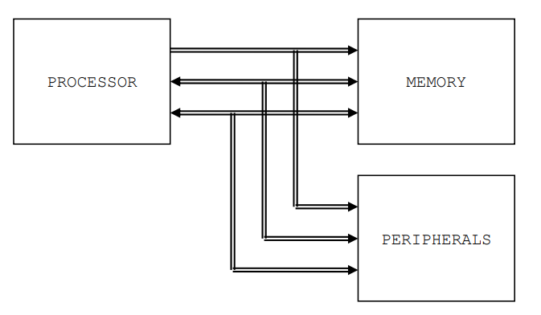
Basic Components of Computer
Section 1.1 BH
Notes:
Processor (CPU)

Slide 10
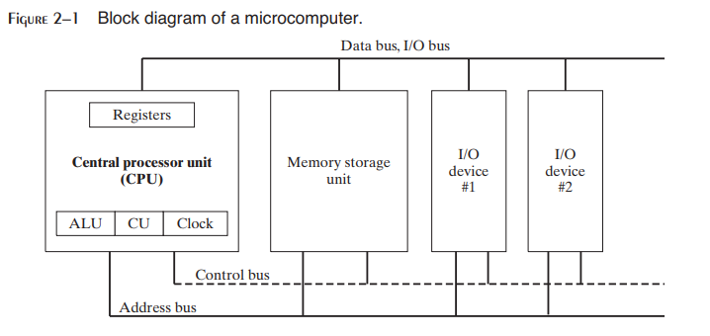
Another diagram
Source KI

Slide 11
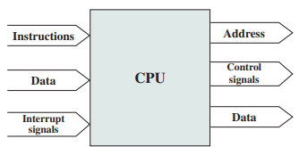
Processor
Processor: The processor reads in instructions and data, writes out data after processing, and uses control signals to control the overall operation of the system. It also receives interrupt signals
ALU, CU & Registers are 3 Distinct CPU Elements
Notes:
(Section 3.3 WS)
Arithmetic and Logic Unit (ALU) - A vast array of logic gates, this component deals with basic arithmetic such as binary addition or subtraction. It is capable of many complex mathematical functions, for example sine, cosine and floating point division.
Control Unit (CU) - A component that co-ordinates the various units inside the processor via the use of "control signals" which determine the flow of data into and around the processor. Instructions are decoded in the Control unit during the FDE cycle.

Slide 12
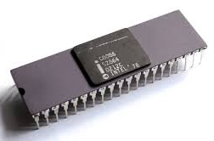
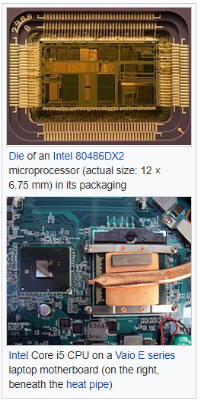
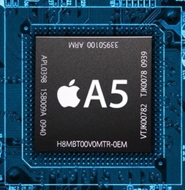
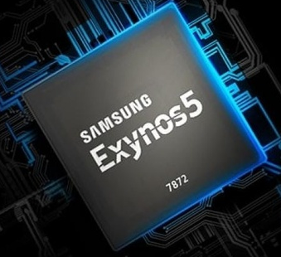

Slide 13
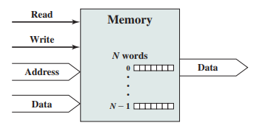
Memory
Memory: Typically, a memory module will consist of N words of equal length. Each word is assigned a unique numerical address (0, 1, c , N-1). A word of data can be read from or written into the memory. The nature of the operation is indicated by read and write control signals. The location for the operation is specified by an address.
Notes:
Page 99 WS (Section 3.3 WS)

Slide 14
Buses
A bus is a communication pathway connecting two or more devices. For example Processor to/from Memory, I/O to/from processor, I/O to/from Memory
The group of bits that the processor uses to inform the memory about which element to read or write is collectively known as the address bus.
Another important bus called the data bus is used to move the data from the memory to the processor in a read operation and from the processor to the memory in a write operation.
The third group consists of miscellaneous independent lines used for control purposes. For example, one line of the bus is used to inform the memory about whether to do the read operation or the write operation. These lines are collectively known as the control bus

Slide 15
A word about registers
Registers are named storage locations in the CPU that hold intermediate results of operations.
As they are located inside CPU they are fastest to access.
Each processor has limited number of registers.

Slide 16
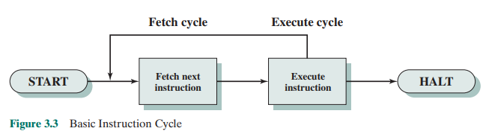
How instructions are executed

Slide 17
Where is Assembly Language?
Up till now the instruction you provided to your computer were in High level language, for example code in C++.
But processor doesn’t understand these high level languages. Its only understands 0 or 1. Called machine Language.
Example of machine instruction to add two registers is
Not very meaningful to us humans, image remembering a something like this for so many more instructions!!

Slide 18
Still, where is Assembly Language?
There are many different types of processors out there, and so many high level programming languages (HLL) are well.
The processors don’t provide a direct way to convert each HLL to machine language.
But each processor comes with its own assembly language, which is much like human readable machine language.
So assembly language lies between HLL and machine language.
Some compilers convert code to assembly before
Example of assembly language instruction to add two registers is
Notes:
Good read: https://cs.stackexchange.com/questions/13287/why-do-we-need-assembly-language
Assembly language consists of statements written with short mnemonics such as ADD, MOV, SUB, and CALL. Assembly language has a one-to-one relationship with machine language: Each assembly language instruction corresponds to a single machine-language instruction.

Slide 19
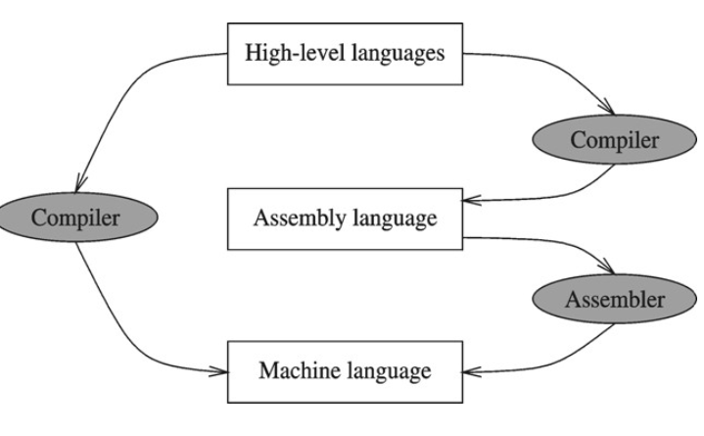
Compiler and Assembler
Some compilers will first convert the code to assembly language and then to machine language (or object code)
Some compilers will directly convert the code to machine language (or object code)
The object code generated is for particular type of processor.

Slide 20
Example:
add.cpp file
gcc -S -o add.s add.cpp
The above command will save the assembler source code of add.cp file in add.s file
Notes:
You might have noticed that in this example and in example given in slide 15 the assembly language seems different. This is because these are for different architechture.

Slide 21
Why need Assembly language?
To better understand the processor.
An assembly language program describes exactly what the hardware should do, step by step, in terms of the basic operations of the hardware. In a high level programming language like C or Java a programmer is mostly unaware of computer architecture.
This can also help in code optimization in terms of space and time.
In some processors it might not be feasible to code in high level languages.

Slide 22
Intel 8086 Processor
There is not just one language called "assembly language.“ Each processor family (such as Intel, VAX, MIPS, Alpha, ...) has its own architecture, organization and machine instructions and a corresponding assembly language.
Learning about one processor and its assembly language is good enough to know how things work.
In this course we will work with intel 8088 16 bit processor, which is a part of inter x86 family of processors.
You will not work with the real processor but with
emulator DosBox
Other tools you will need are assembler and debugger

Slide 23
Reading and References
Reading
Section 1.1.1 Kip Irvine
Section 1.1 Bilal Hashmi
References
Chapter 1 KI
Chapter 3 WS
Chapter 1 BH
Chapter 1 https://chortle.ccsu.edu/assemblytutorial/index.html

